Slide 1
Capstone project
Customer Segmentation for Retention Strategy

Slide 2
Project Brief
Your Role: Junior Data Analyst at a large department store marketplace connecting small businesses from all over Brazil to channels without hassle and with a single contract.
Business Challenge: The Marketing director needs to optimize campaign spending. Currently, the team sends same promotions to ALL customers which is expensive and ineffective.
The team wants to launch targeted campaigns but does not know which customers to prioritize.
Goal: Build an RFM customer segmentation model and create a Dashboard for the stakeholders.
Notes:
Not all analytical models rely on machine learning or artificial intelligence. Some are rule-based models, which use logical conditions or business rules instead of algorithms that “learn” from data.

Slide 3
RFM
If you could only know 3 things about each customer to make marketing decisions, what would they be?
Notes:
“How often they buy.”
“How much money they spend.”
“When they last bought something.”
“What products they like.”
“How long they’ve been a customer.”
“Where they’re located.”
“Their age or income.”
“If they open emails or respond to promos.”
“How satisfied they are.”

Slide 4
R F M
RFM = Recency Frequency Monetary
customer segmentation method that groups customers based on 3 simple metrics:
R: RECENCY
ex: How recently did they purchase?
→ Recent buyers are more engaged
F: FREQUENCY
ex: How often do they purchase?
→ Frequent buyers tend to be more loyal
M: MONETAFRY
ex: How much money they spent?
→ Big spenders are more valuable
rule-based model analyzing and segmenting customers based on their purchasing or engagement behaviour.
Notes:
Interesting! You mentioned how recently they bought, how often they buy, and how much they spend — those three are actually the foundation of one of the most widely used marketing analytics frameworks in data science: RFM Analysis.”
RFM is a simple yet powerful rule-based model used by businesses to analyze and segment customers based on their purchasing or engagement behavior.

Slide 5
Why rfm?
Recency
Someone who bought yesterday is more likely to buy again than someone who bought 6 months ago
predicts engagement and churn risk
Frequency
Repeat customers tend to be more loyal
Shows satisfaction and market fit
Cheaper to retain than acquire new customers
Monetary
Not all customers are equally valuable
helps prioritize resources

Slide 6
real world applications
Banking
R: days since last transaction/login
F: no. of transactions per month
M: average daily balance (ADB), balance
Ecommerce
R: days since last order, trend in purchase timing (accelerating or slowing)
F: no. of orders, no. of unique orders
M: total amount spent
Apps
R: days since last login/session
F: no. of sessions per week
M: subscription tier value

Slide 7
Calculating rfm

Slide 8
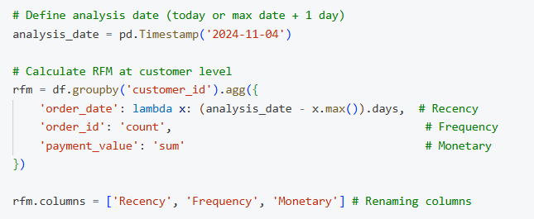
Sample Dataset: current date = 2024-11-04
Customer | Last Purchase Date | # Orders | Total Spent (Php)
Alice | 2024-10-30 | 15 | 3,000
Bob | 2024-04-15 | 1 | 100
Carol | 2024-09-20 | 8 | 1,500
Dave | 2024-11-01 | 2 | 400
Calculate RFM
Customer | Recency | Frequency | Monetary
Alice | 5 days | 15 | 3,000
Bob | 203 days | 1 | 100
Carol | 45 days | 8 | 1,500
Dave | 3 days | 2 | 400
Notes:
You already know how to do this! It's just pandas groupby and aggregation

Slide 9

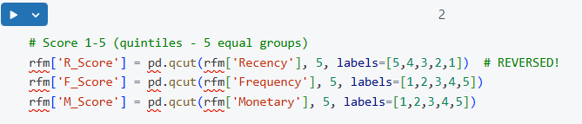
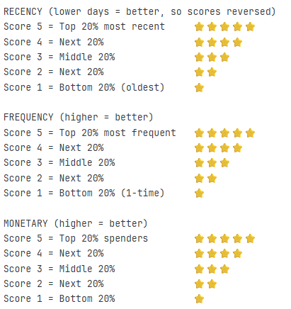
Scoring system
Converting RFM to Scores (1-5) WHY score? Raw numbers are hard to compare. Score standardize them.
Note: Recency is REVERSED!
Lower days = better = higher score
What the scores mean?
Quantiles (pd.qcut()): automatically divides data into equal-sized groups (best for balanced data) (not to be used in capstone)
EDA before Scoring!
Look at histograms or boxplots for Recency, Frequency, and Monetary.
Check for skewness, outliers, and clusters.
If data is highly skewed:
set custom thresholds manually instead of quantiles.
apply transformations (like log scale) to make the data more even before scoring.
Notes:
The most recent 20% of customers get a 5 (best score),
The next 20% get a 4, and so on.
This is a quick, automated way to assign scores based on ranking, not raw values.
Quantiles are great when your data is roughly evenly distributed — meaning values are spread out fairly consistently.
If your data is skewed (for example, most customers spend very little, but a few spend a lot), quantiles can create misleading thresholds:
Before choosing quantiles, always do EDA (Exploratory Data Analysis):
Look at histograms or boxplots for Recency, Frequency, and Monetary.
Check for skewness, outliers, and clusters.
If data is highly skewed:
You might set custom thresholds manually instead of quantiles.
Or apply transformations (like log scale) to make the data more even before scoring.

Slide 10
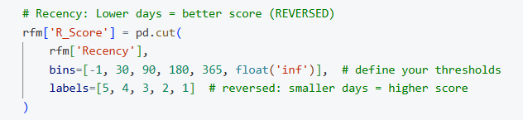
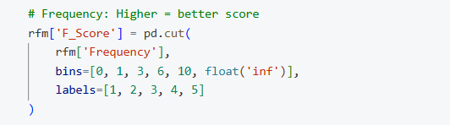
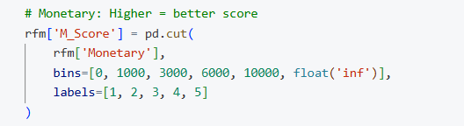
Manual scoring approach (rule-based)
recommended when data is skewed or you want business defined methods.
After doing EDA (checking distributions or typical value ranges), you can manually define bins or thresholds for each RFM dimension. ~You decide what counts as “recent” or “valuable” based on patterns in your data

Slide 11
Creating segments

Slide 12
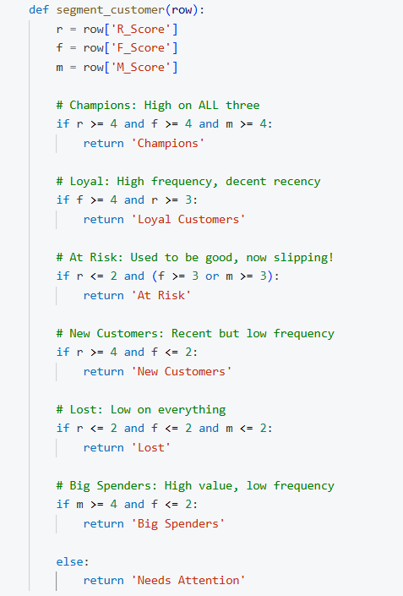
RULE-based segmentation
📊 Segment Profiles
Segment | RFM Pattern | Business Meaning | Marketing Action
🏆 Champions | 555, 554, 544 | Best customers! Recent, frequent, high-value | VIP perks, referral program, early access
❤️ Loyal | High F, decent R | Frequent buyers | Loyalty rewards, upsell premium
⚠️ At Risk | Low R, high F/M | Used to be great, now slipping | Win-back campaign, "We miss you" discount
😢 Lost | 111, 211, 122 | Inactive, low value | Last attempt or remove from list
🆕 New | High R, low F | First/second purchase | Welcome series, encourage repeat
💰 Big Spenders | High M, low F | Rare but valuable | Exclusive offers, VIP treatment
Notes:
Now that we’ve assigned R, F, and M scores to each customer, we can translate those numbers into meaningful business segments — this is called rule-based segmentation.
On the left, you’ll see how we define each group using logical conditions. For example, if a customer scores high on all three dimensions — recency, frequency, and monetary — they’re our Champions. These are our best customers: recent, frequent, and high-value.
Next, we have Loyal Customers, who buy frequently but maybe not as recently — they’re still active and worth retaining through loyalty perks or upsell offers.
Then we have At Risk customers — they used to be active but haven’t engaged lately. These are perfect targets for reactivation campaigns like “We miss you” discounts.
Lost customers are low on everything — they’re inactive and not bringing much value. Sometimes it’s best to remove them from active marketing lists.
New Customers are recent but not yet frequent — they’ve just started buying, so we nurture them with welcome or repeat-purchase incentives.
And finally, Big Spenders might not buy often, but when they do, they spend a lot. These customers deserve exclusive treatment or VIP offers.
So, this segmentation allows us to go beyond raw data — we now have profiles we can act on with specific marketing strategies for each group

Slide 13
Updated Schedule
Date | Activity
Nov. 05 | Pandas Viz I (Matplotlib continuation) Capstone Introduction and RFM Discussion
Nov. 07 | Pandas Viz II (Seaborn)
Nov. 12 | Pandas Viz II - continuation
Nov. 14 | Basic SQL I
Nov. 19 | Basic SQL II
Nov. 21 | Activity on Data Extraction and/ Viz Reporting Consultation
Nov. 24 (Monday) | Capstone Consultation (1st hour) & Presentation
Nov. 25 (Tuesday) | Capstone Presentation (extra day)
Reminder/s:
Submit all activities prior capstone

Slide 14
Capstone Requirements
Deck
Technical
Data
Process Done
Business
Insights/Findings
Recommendations
Dashboard
All requirements in the Capstone Instructions pdf.
Capstone Groupings
Group 1 | Group 2 | Group 3 | Group 4 | Group 5
Lance | Nat | Jet | Alec | Josh
Liam | Jhon Mark | Ivan | Niv | Louie
Clarence |  |  | Rogelio | Adrian Lee

Slide 15
THANK YOU

